Slide 1
Case Study 4: Farthest Airport from NYC
Group 6: Candice Kasahara, Leah Bargnesi, Ian Troidl

Slide 2
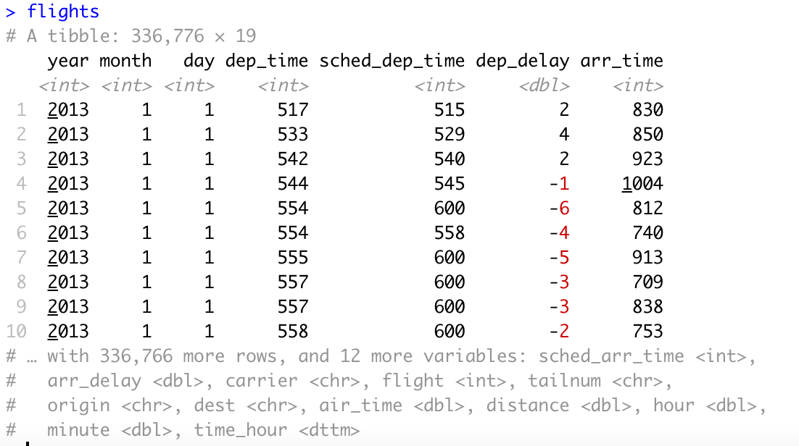

Goal: What is the full name (not the three letter code) of the destination airport farthest from any of the NYC airports in the flights table?

Slide 3
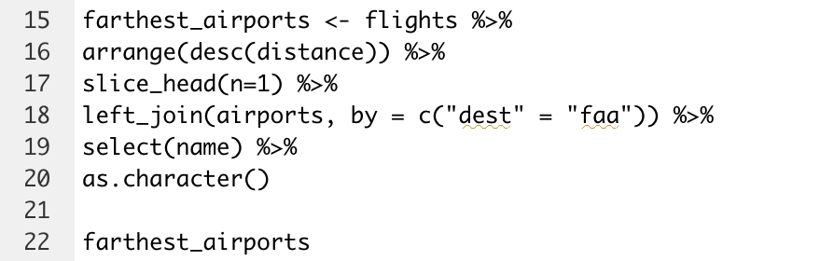
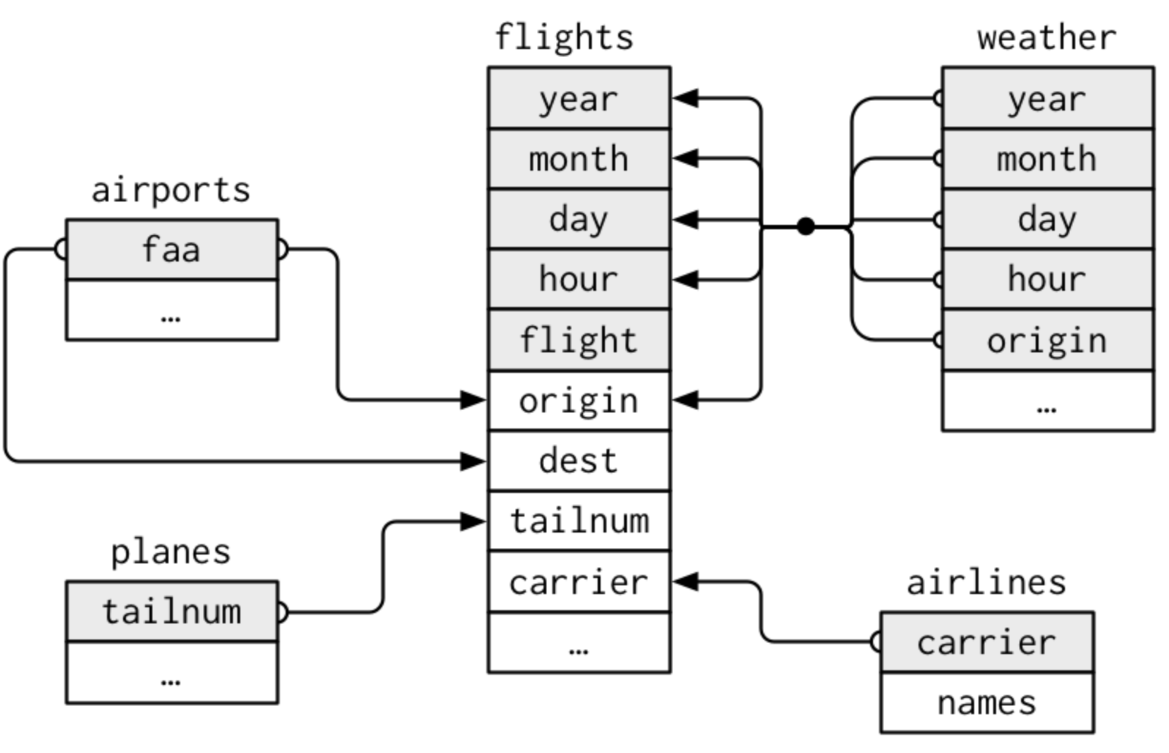

Farthest Airport: Honolulu Intl.

